Slide 1
Of the months (OTMs)
Jared Kimbrell
National Residence Hall Honorary

Slide 2
Of The Months
OTMs are “Of the Months” which are a way to recognize the amazing things going on at your campus.
The recognition starts on your campus level and can possibly reach regional and NACURH levels.
There are two types of OTMs: Individuals and Programs
General: For a person you feel has done amazing work for that month.
Program: A Program that you really enjoyed attending or throwing.

Slide 3
Categories
General
Program
Educational
Diversity
Community Service
Passive
Social
Advisor
Executive Board Member:
First Year Student
Institution Faculty/Staff
Student
Organization
Residence Life Faculty/Staff
Resident Assistant
Student Staff Member
Residential Community
Spotlight

Slide 4
Why to Write An OTM
To give a person/group/event recognition for their hard work during a specific month
Give Oklahoma State Recognition on a Regional and possibly National level
Selected campus winners –> Regional Winners –> National Winners
Hall Cup Points
Your OTM gets sent to whomever you write about

Slide 5
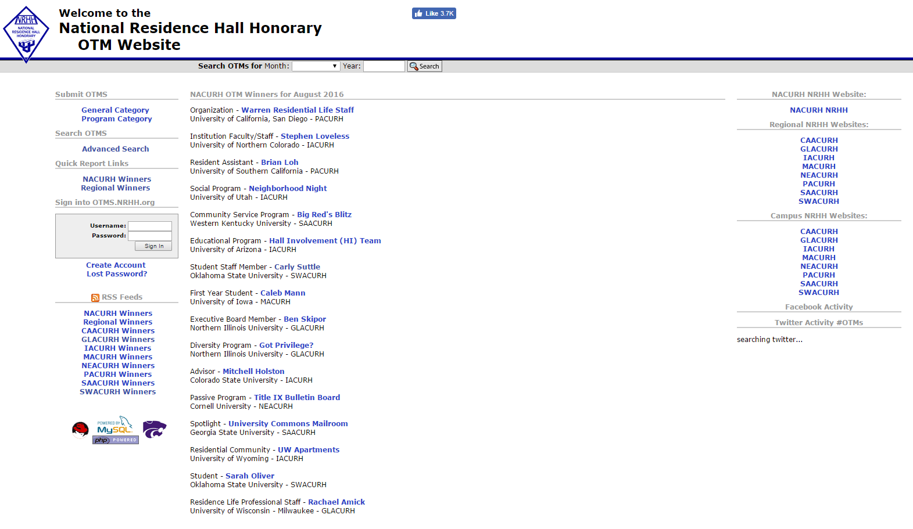
How to Write An OTM
Go to otms.nrhh.org
No Account? For a quick submission just click one of these and start writing!
Create An Account to keep track of OTMs you write & allows you to edit OTMs until they’re submitted to campus selection!

Slide 6
Submitting an OTM
Select University: Oklahoma State University

Slide 8
Last Bit of Info
OTMs are due the 7th of each month at 11:50PM
Of the Months should be written about things that happened in that month
If you want to win on a regional or national level have around 450 words
You shouldn’t go above the word requirement! (600 words)

